Slide 1
MARKETING STRATEGIES CHESAPEAKE PUBLIC SCHOOLS SCHOOL NUTRITION SERVICES
Alliance Winter Conference
January 27, 2016
Presented by
Joanne Kinsey, Director

Slide 2
Strategy I
Customer Online Survey
Using
as the method of posting on school websites, a survey link for SNS feedback was posted for parent/community input.

Slide 3
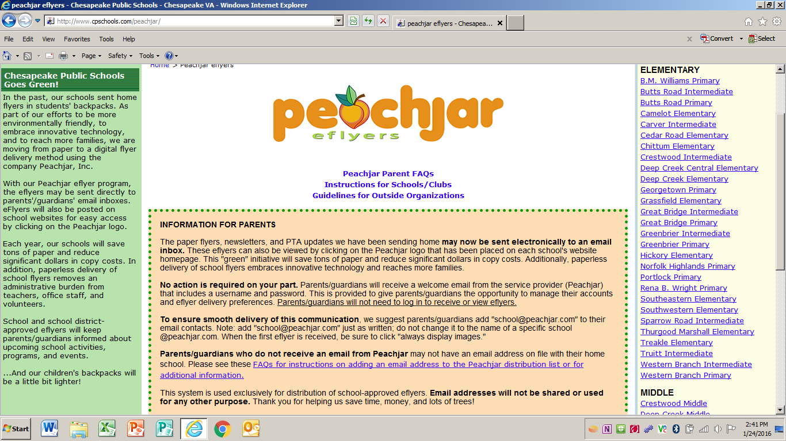

Slide 6
Strategy II
Utilize mobile bus/Nutrition Express to deliver nutrition education to students
Teachers sign up for school visit using online form
Nutrition Educator delivers lesson on bus and provides a healthy snack

Slide 7
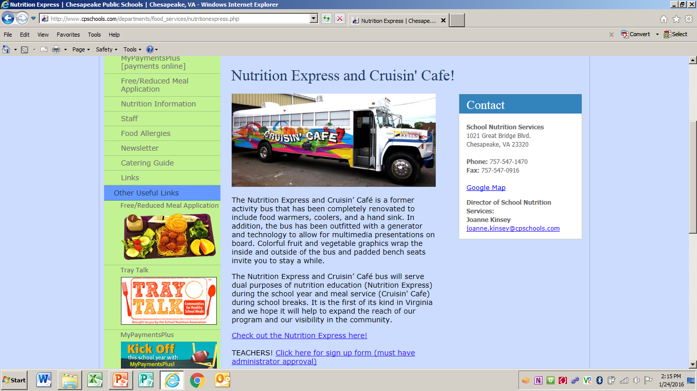

Slide 9
Strategy III
Market menus using Nutrislice web based menu system
Product also offers app for mobile devices
Promote menus for all grade levels
Allows users to identify major allergens within food items and also provides nutritional information for each menu option

Slide 10
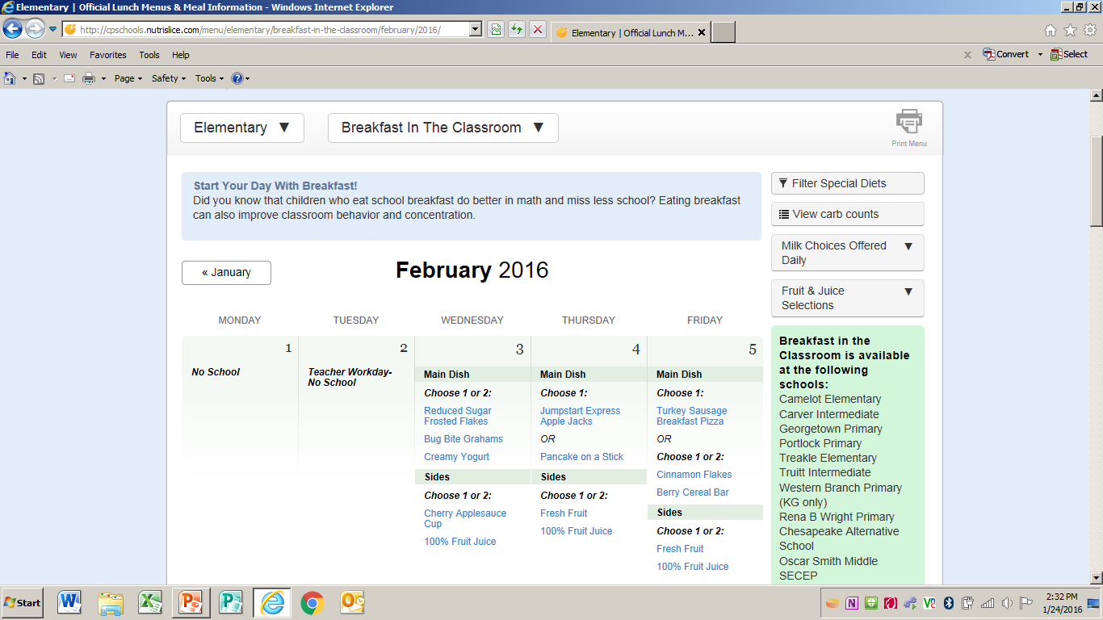

Slide 11
Strategy IV
Information fact sheets for Breakfast in the Classroom
In an effort to education students and teachers on the food components of a reimbursable meal, posters were created for each daily menu.

Slide 12
